Slide 1
Hash Tables

Slide 2
Introduction
Last lesson we saw:
  linear search – O( n )
  binary search – O( log n )
Can we improve the search operation to achieve better than O( log n ) time?

Slide 3
Comparison-Based Searches
To locate an item, the target search key has to be compared against the other keys in the collection.
  O( log n) is the best that can be achieved.
  We must use a different technique if we want to improve the search time.

Slide 4
Hashing
The process of mapping a search key to a limited range of array indices.
  The goal of providing direct access to the keys.
  hash table – the array containing the keys.
  hash function – maps a key to an array index.

Slide 5
Hashing Example
Suppose we have the following set of keys
and a hash table, T, with M = 13 elements.
We can define a simple hash function h()
765, 431, 96, 142, 579, 226, 903, 388
h(key) = key % M

Slide 6
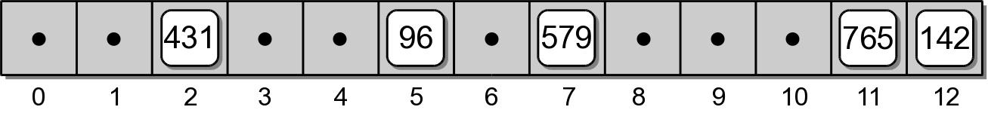
Adding Keys
To add a key to the hash table:
  Apply the hash function to determine the array index in which the key should be stored.
    h(765) => 11
    h(431) => 2
    h(96) => 5
    h(142) => 12
    h(579) => 7
  Store the key in the given slot.

Slide 7
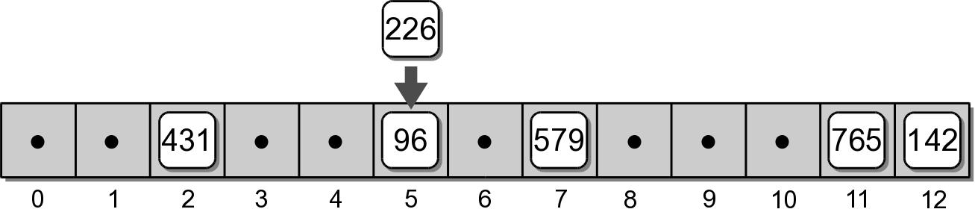
Collisions
What happens when we attempt to add key 226?
    h(226) => 5
collision – when two or more keys map to the same hash location.

Slide 8
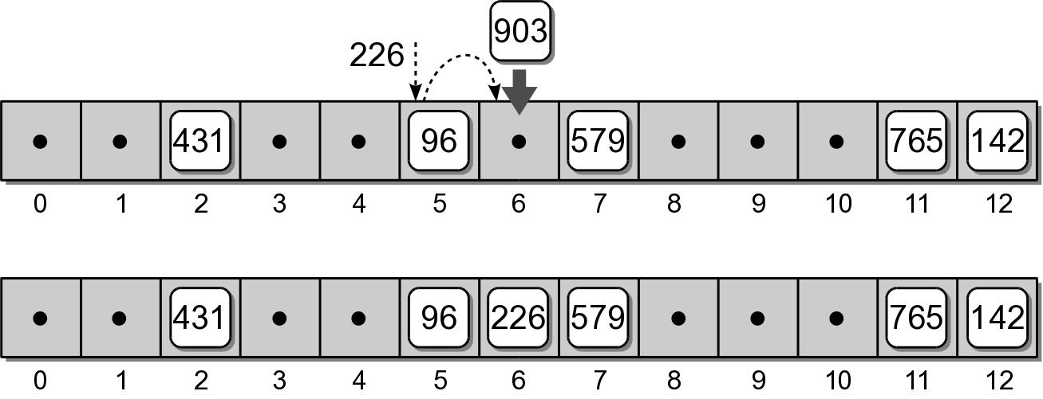
Probing
If two keys map to the same table entry, we must resolve the collision to find another available slot.
  linear probe – simplest approach which examines the table entries in sequential order.

Slide 9
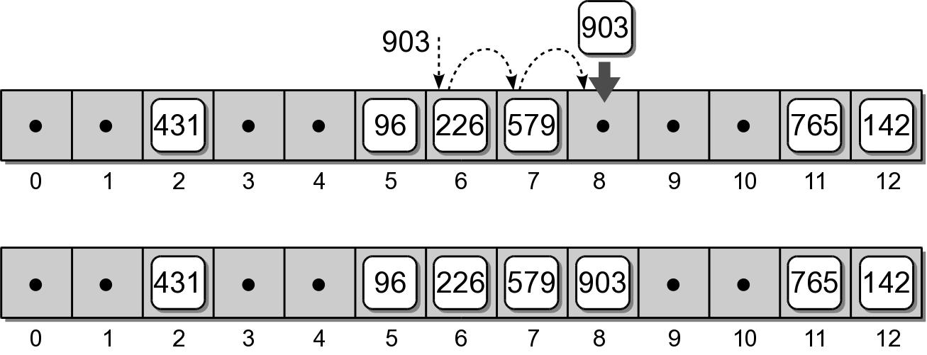
Probing
Consider adding key 903 to our hash table.
    h(903) => 6

Slide 10
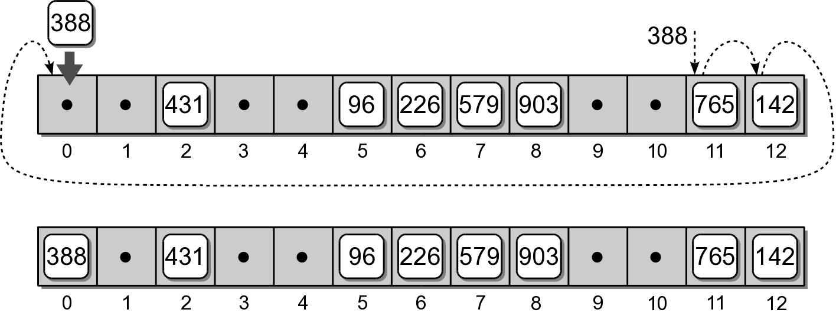
Probing
If the end of the array is reached during the probe, it wraps around to the first entry and continues.
  Consider adding key 388 to our hash table.
    h(388) => 11

Slide 11
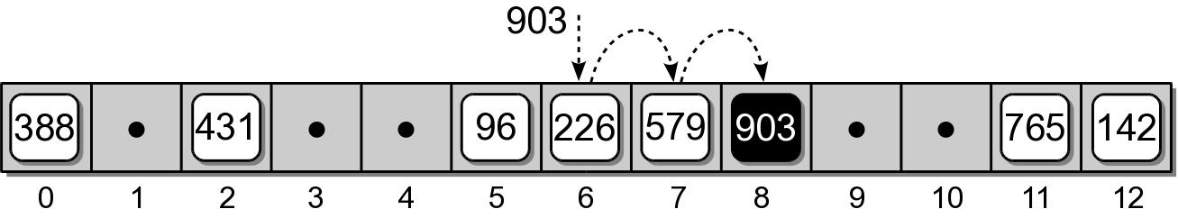
Searching
Searching a hash table for a specific key is very similar to the add operation.
  Target key is mapped to an initial slot.
  See if the slot contains the target.
  Otherwise, apply the same probe used to add keys to locate the target.
Example: search for key 903.

Slide 12
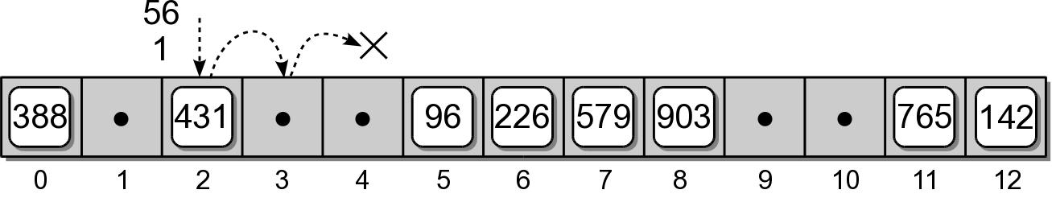
Searching
What if the key is not in the hash table?
The probe continues until either:
  a null reference is reached, or
  all slots have been examined.

Slide 13
Deleting Keys
Deleting a key from a hash table is a bit more complicated than adding keys.
  We can search for the key to be deleted.
  But we cannot simply remove it by setting the entry to None.

Slide 14
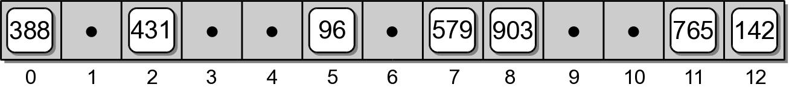
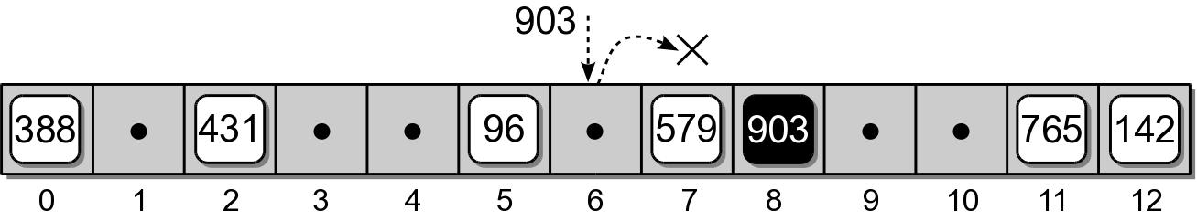
Incorrect Deletion
Suppose we simply remove key 226 from slot 6.
What happens if we search for key 903?

Slide 15
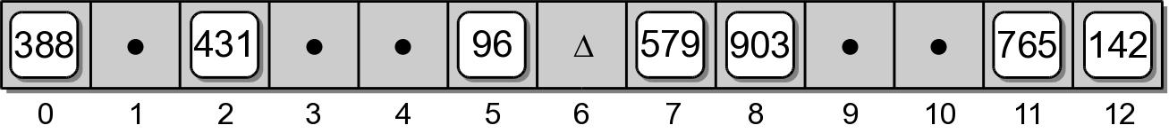
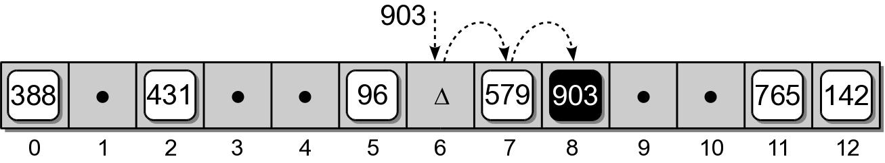
Correct Deletion
We use a special flag to indicate the entry is now empty, but was previously occupied.
When searching a hash table, the probe must continue past the slot(s) with the special flag.

Slide 16
Clustering
The grouping of keys in a common area.
  As more keys are added to the hash table, more collisions are likely to occur.
  Clusters begin to form due to the probing required to find an empty slot.
  As a cluster grows larger, more collisions will occur.
primary clustering – clustering around the original hash position.

Slide 17
Probe Sequence
The order in which the hash entries are visited during a probe.
  The linear probe steps through the entries in sequential order.
  The next array slot can be represented as
  where
    i is the i^{th} probe.
    home is the home position
slot = (home + i) % M

Slide 18
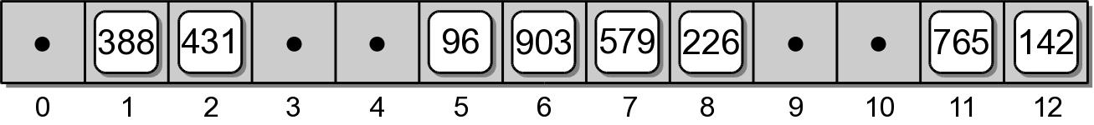
Modified Linear Probe
We can improve the linear probe by changing the step size to some fixed constant.
Suppose we set c = 3 to build the hash table.
slot = (home + i * c) % M
h(765) => 11 h(579) => 7
h(431) => 2 h(226) => 5 => 8
h(96) => 5 h(903) => 6
h(142) => 12 h(388) => 11 => 1

Slide 19
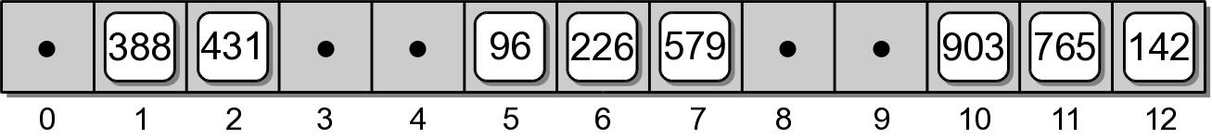
Quadratic Probing
A better approach for reducing primary clustering.
Increases the distance between each probe in the sequence.
Example:
slot = (home + i**2) % M
h(765) => 11 h(579) => 7
h(431) => 2 h(226) => 5 => 6
h(96) => 5 h(903) => 6 => 7 => 10
h(142) => 12 h(388) => 11 => 12 => 2 => 7 => 1

Slide 20
Quadratic Probing
Reduces the number of collisions.
Introduces the problem of secondary clustering.
  When two keys map to the same entry and have the same probe sequence.
Example: add key 648
  hashes to entry 11
  follows the same sequence as key 388

Slide 21
Double Hashing
When a collision occurs, a second hash function is used to build a probe sequence.
  Step size remains a constant throughout the probe.
  Multiple keys that have the same home position, will have different probe sequences.
slot = (home + i * hp(key)) % M

Slide 22
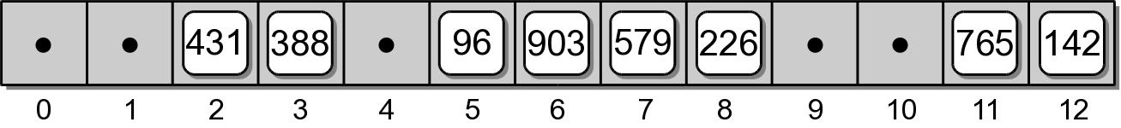
Double Hashing
A simple choice for the second hash function.
Example: let P = 8
hp(key) = 1 + key % P
h(765) => 11 h(579) => 7
h(431) => 2 h(226) => 5 => 8
h(96) => 5 h(903) => 6
h(142) => 12 h(388) => 11 => 3

Slide 23
Table Size
How big should a hash table be?
  If we know the max number of keys.
    create it big enough to hold all of the keys.
  In most instances, we don't know the number of keys.
Most probing techniques work best when the table size is a prime number.

Slide 24
Rehashing
We can start with a small table and expand it as needed.
  Similar to the approach used with the vector.
load factor – the ratio between the number of keys and the size of the table.
  A hash table should be expanded before the load factor reaches 80%.

Slide 25
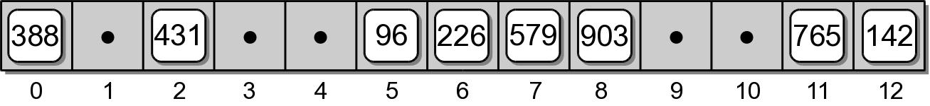
Rehashing Example
After creating a larger array for the table, we can not simply copy the original keys to the new table.
We must rebuild or rehash the entire table.
h(765) => 0 h(579) => 1
h(431) => 6 h(226) => 5
h(96) => 11 h(903) => 2
h(142) => 6 => 7 h(388) => 14

Slide 26
Expansion Size
Size of the expansion depends on the application.
Good rule of thumb is to at least double its size.
Two common approaches:
  double the size of the table, then search for the first larger prime number.
  double the size of the table and add one to ensure M is odd.

Slide 27
Efficiency Analysis
Depends on:
  the hash function
  size of the table
  type of collision resolution probe
Once an empty slot is located, adding or deleting a key can be done in O(1) time.
The time required to perform the search is the main contributor to the overall time of all ops.

Slide 28
Efficiency Analysis
Best case: O(1)
  The key maps directly to the correct entry.
  There are no collisions.
Worst case: O(m)
  Assume there are n keys stored in a table of size m.
  The probe has to visit every entry in the table.

Slide 29
Efficiency Analysis
While hashing appears to be no better than a basic linear search, hashing is very efficient in the average case.
Load Factor | 0.25 | 0.5 | 0.67 | 0.8 | 0.99
Successful search:
Linear probe | 1.17 | 1.50 | 2.02 | 3.00 | 50.50
Quadratic probe | 1.66 | 2.00 | 2.39 | 2.90 | 6.71
Unsuccessful search:
Linear probe | 1.39 | 2.50 | 5.09 | 13.00 | 5000.50
Quadratic probe | 1.33 | 2.00 | 3.03 | 5.00 | 100.00

Slide 30
Separate Chaining
We can eliminate collisions altogether if we store the keys outside the table.
  chains – use linked lists to store keys that map to the same entry.
  The hash table becomes an array of linked lists.
  After mapping the key to an entry in the table, the linked list is searched for the key.

Slide 31
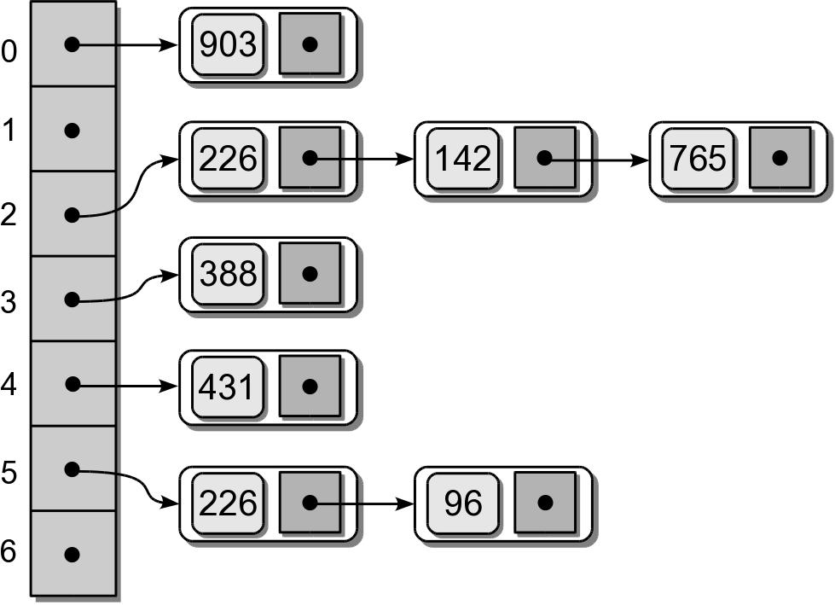
Separate Chaining

Slide 32
Efficiency: Separate Chaining
Very efficient in the average case.
  If there are n keys and m entries, the average list length is
  Successful search:
  Unsuccessful search:
α = n/m
1 + α/2
1 + α

Slide 33
Hash Functions
The efficiency of hashing depends in large part on the selection of a good hash function.
  A “perfect” function will map every key to a different table entry.
    This is seldom achieved except in special cases.
  A “good” hash function distributes the keys evenly across the range of table entries.

Slide 34
Function Guidelines
Important guidelines to consider in designing a hash function.
  Computation should be simple.
  Resulting index can not be random.
  Every part of a multi-part key should contribute.
  Table size should be a prime number.

Slide 35
Common Hash Functions
Division – simplest for integer values.
Truncation – some columns in the key are ignored.
  Example: assume keys composed of 7 digits.
  Use the 1st, 3rd, 6th digits to form an index (M = 1000).
h(key) = key % M

Slide 36
Common Hash Functions
Folding – key is split into multiple parts then combined into a single value.
  Given the key value 4873152, split it into three smaller values (48, 73, 152).
  Add the values together and use with division.

Slide 37
Hashing Strings
Strings can also be stored in a hash table.
  Convert to an integer value that can be used with the division or truncation methods.
Simplest approach: sum the ASCII values of individual characters.
  Short strings will not hash to larger table entries.
Better approach: take char position into account

